Slide 1

Sales Data Analysis using Lambda architecture
Presented By: Tahir Hassan (Ds-011/2022)

Slide 2
Table of contents
Introduction
Problem Statement
Lambda Architecture
Azure Services
Workflow Diagram
Implementation
Results and Achievements
Conclusion

Slide 3
Introduction
sales analysis within the realm of Big Data analytics signifies a paradigm shift in how businesses approach understanding, predicting, and optimizing sales performance.
Harnessing the power of Big Data analytics empowers organizations to unravel hidden insights, drive innovation, and stay agile in an ever-evolving marketplace.
Big Data analytics presents unparalleled opportunities to gain a competitive edge, enhance operational efficiency, and optimize sales strategies.

Slide 4
Problem Statement
Current sales analysis lacks depth, offering limited insights into consumer behavior, market trends, and product performance.
Absence of real-time data results in delayed decision-making, leading to missed opportunities and less agile responses to market changes.
Without a comprehensive analysis, resources are allocated ineffectively, affecting marketing strategies, inventory management, and sales distribution

Slide 5
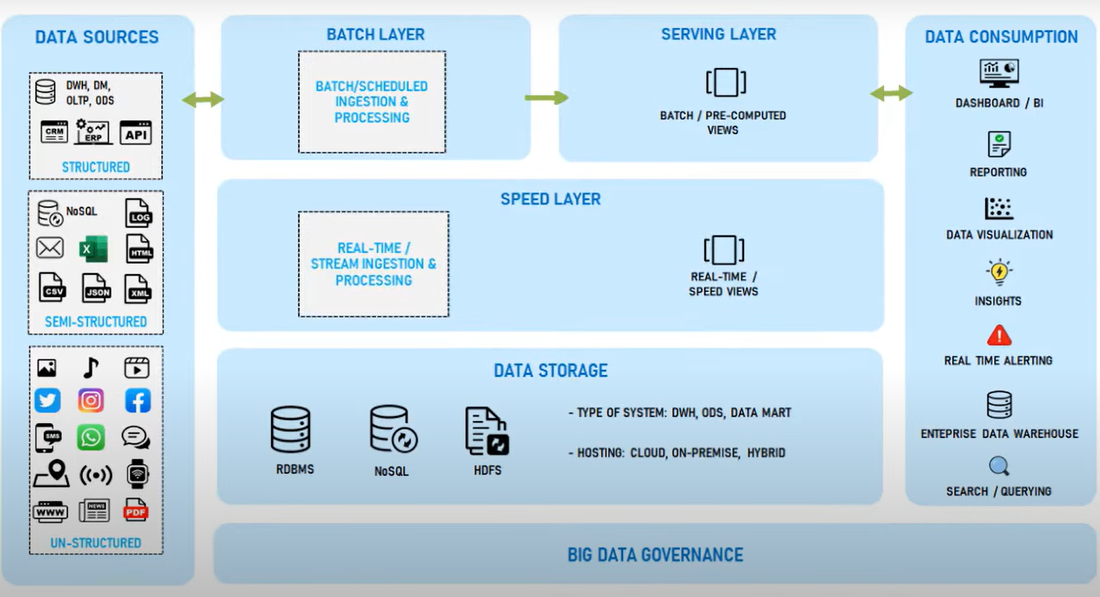
Lambda Architecture
Lambda Architecture is a robust big data processing framework designed for handling both batch and real-time data.
Consisting of three layers Batch, Speed, and Serving layer addresses the challenges of large-scale and diverse datasets.
The batch layer processes large volume of historical data in a scalable manner.
The speed layer provides real-time processing and analytics of recent data for immediate insights.
Serving layer provides unified views of both batch and speed layer

Slide 6
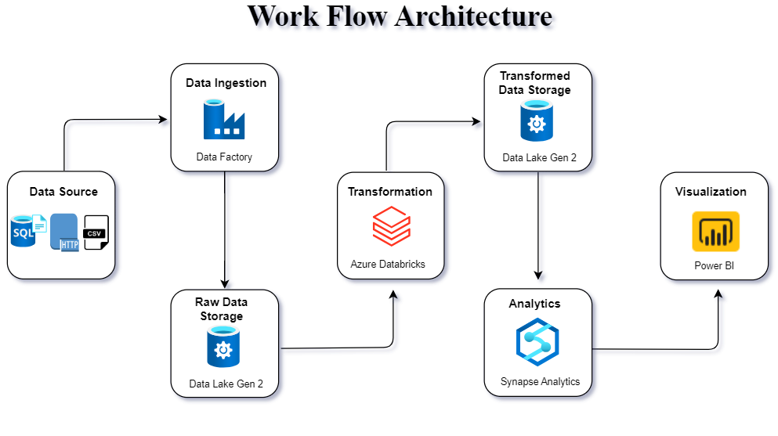
Workflow Diagram

Slide 7
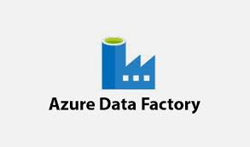

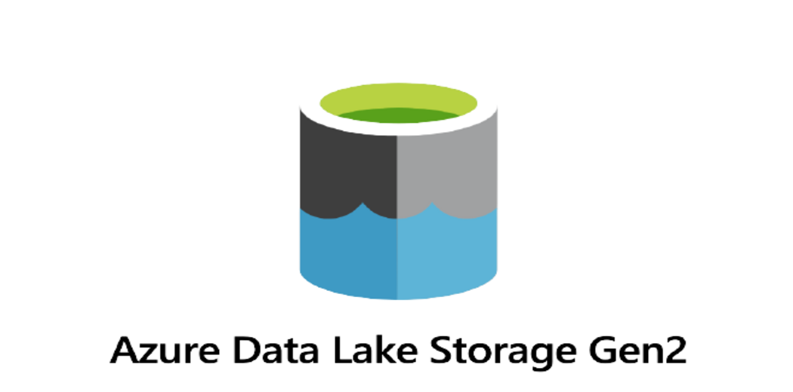

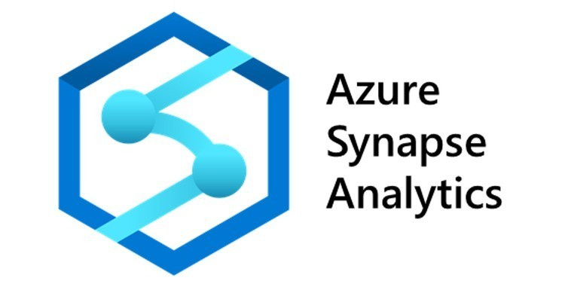
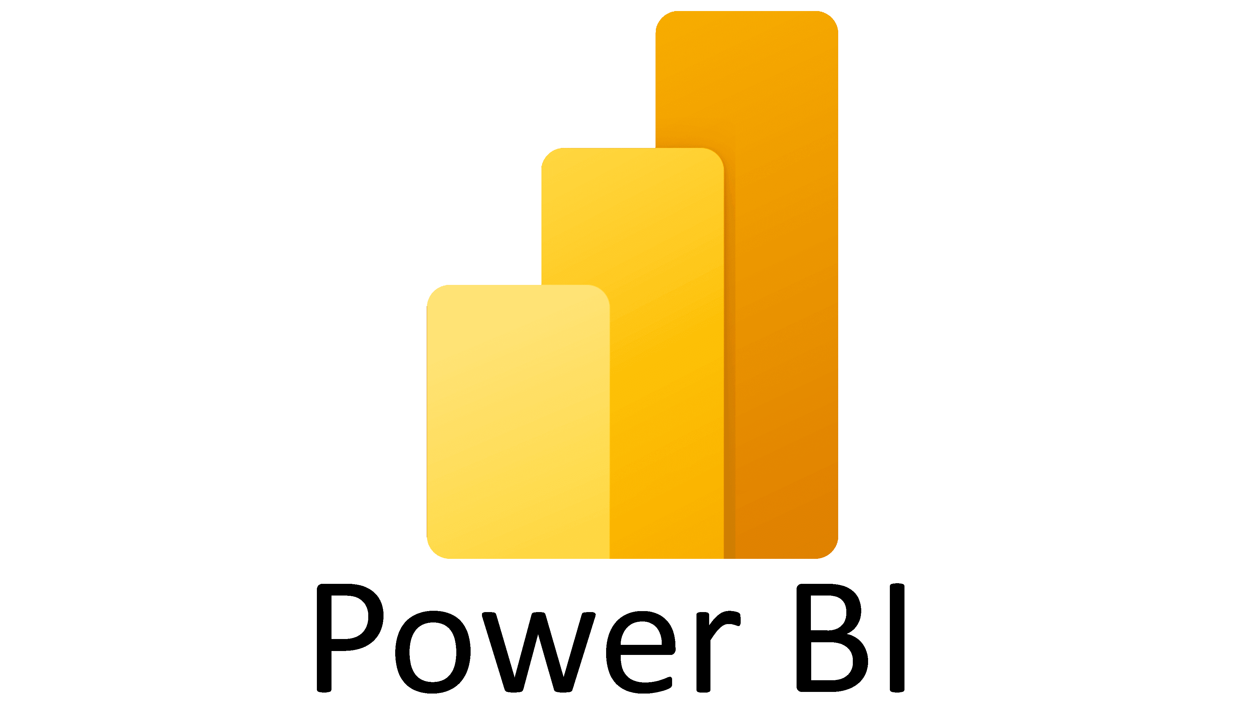
Microsoft azure SERVICES
AZURE DATA FACTORY
AZURE DATA LAKE GEN2
AZURE DATABRICKS
AZURE SYNPSE ANALYTICS
POWERBI

Slide 8
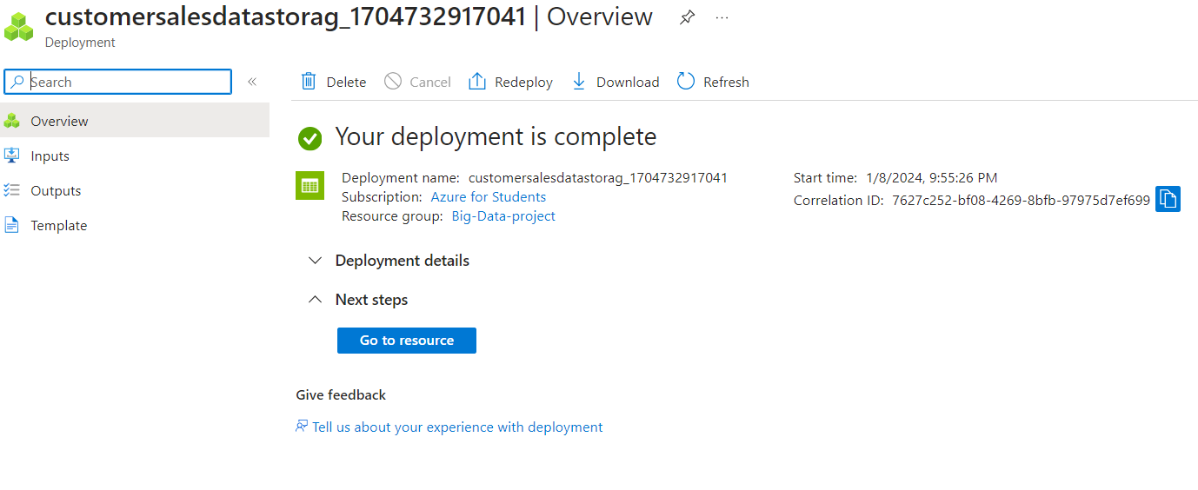
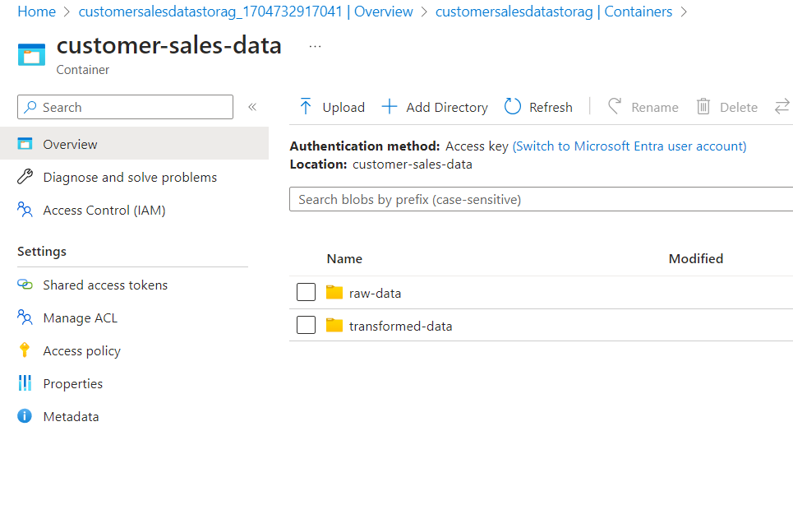
Implementation – Data lake Gen2

Slide 9
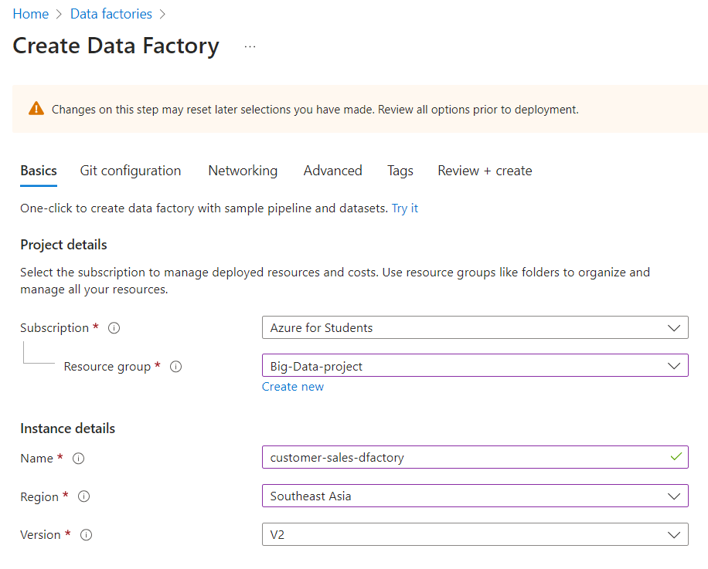
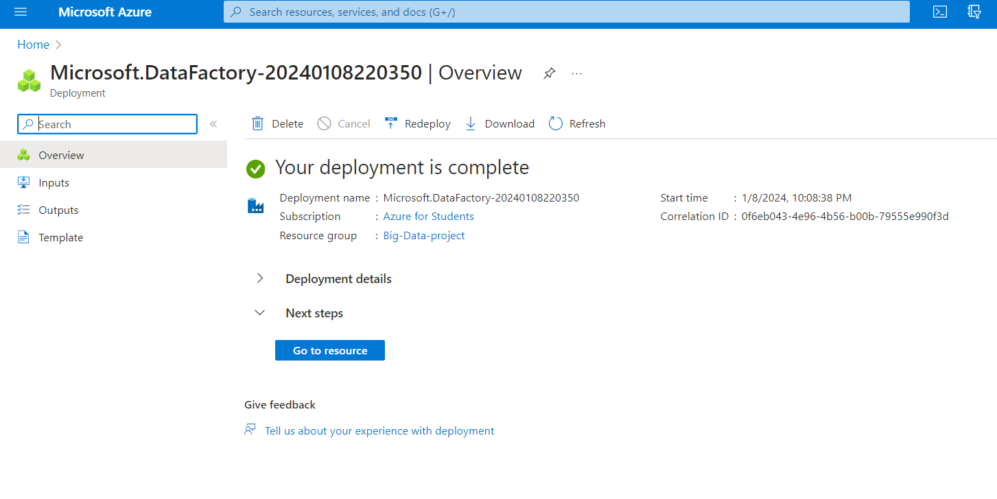
Implementation – Azure Data factory

Slide 10
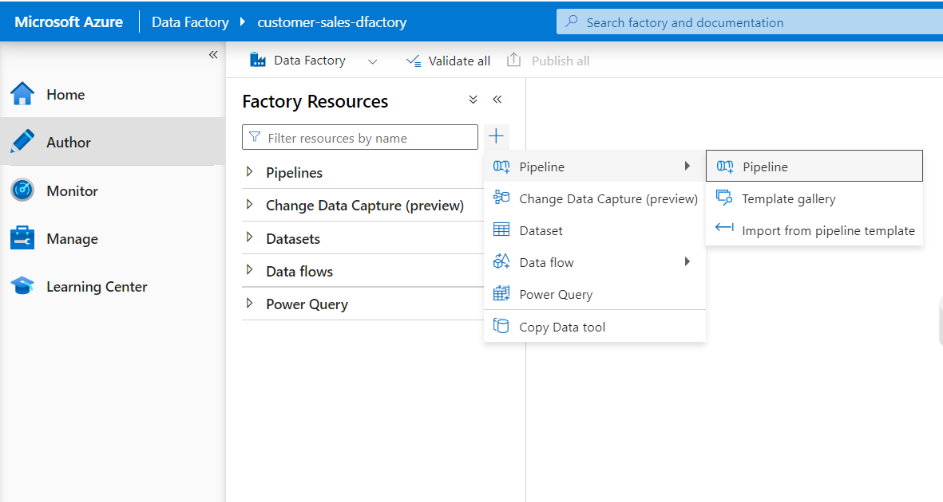
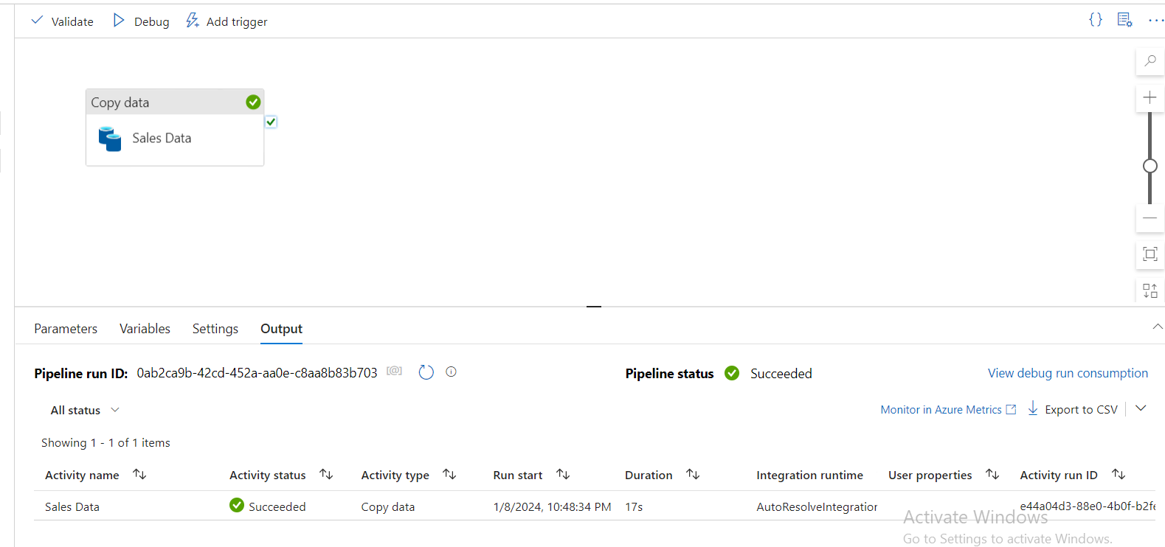
Implementation – Data Ingestion

Slide 11
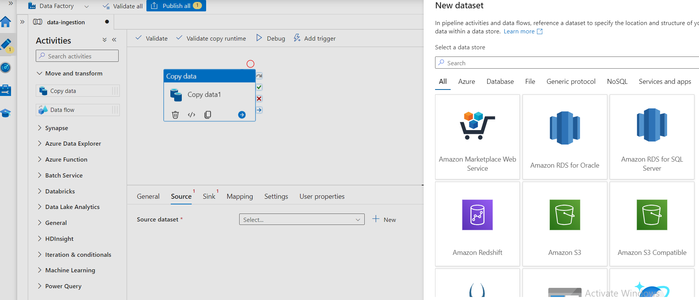
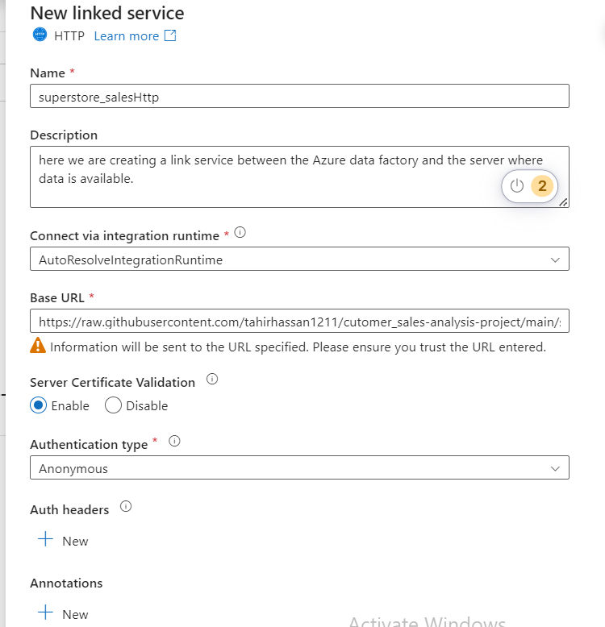
Implementation – Data Ingestion

Slide 12
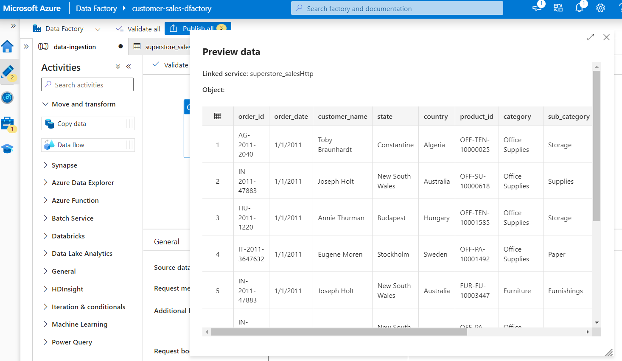
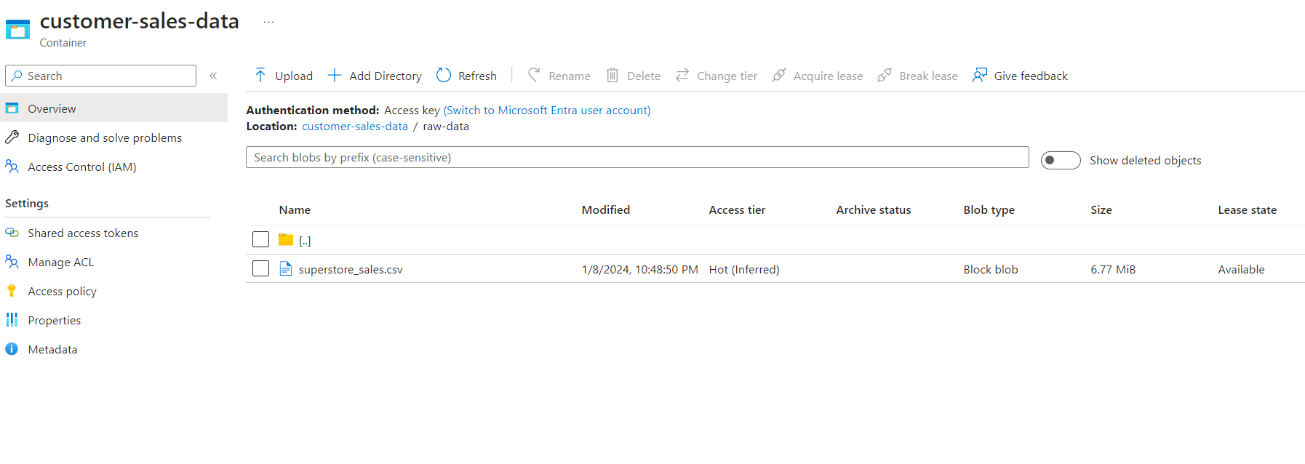
Implementation – Data Storage

Slide 13
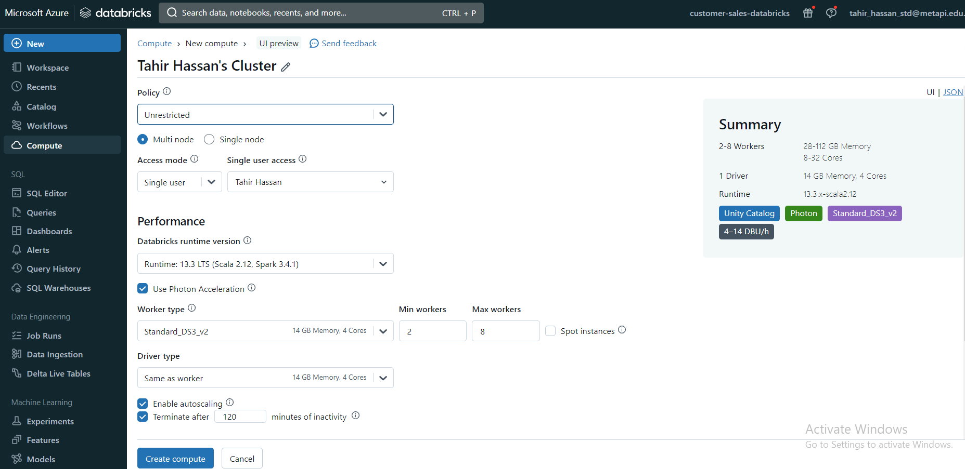
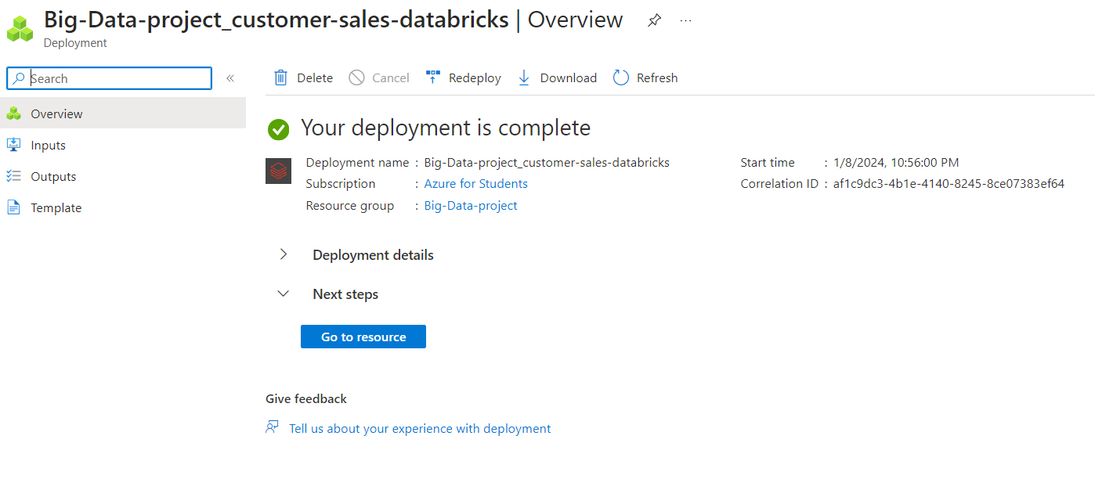
Implementation – Azure databricks

Slide 14
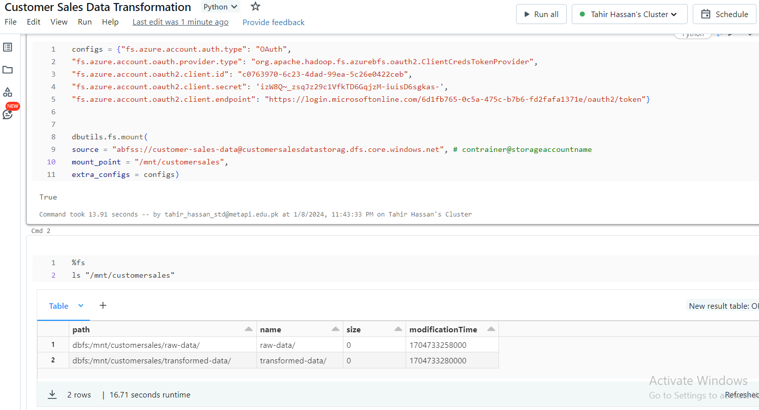
Implementation – Azure databricks

Slide 15
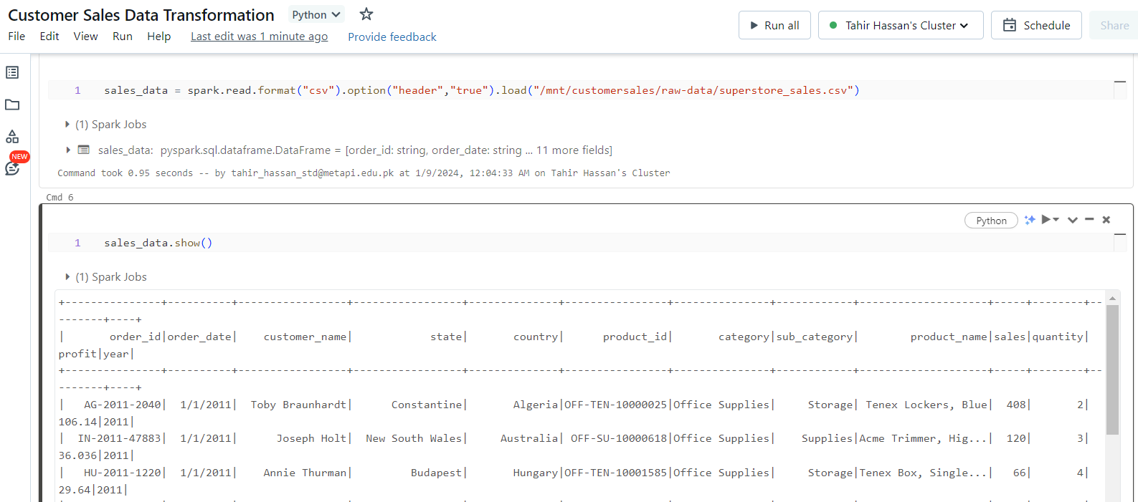
Implementation – Azure databricks

Slide 16
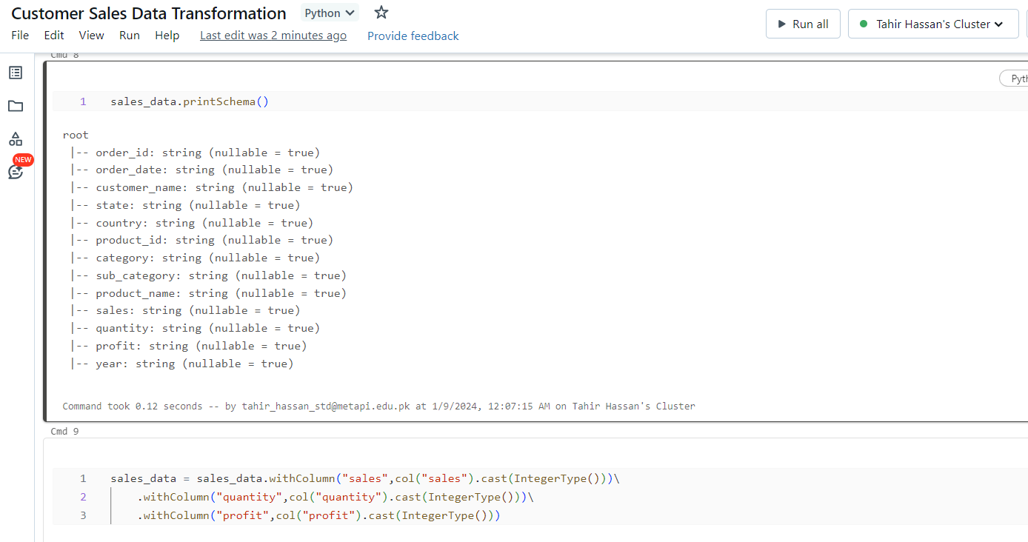
Implementation – Transformation

Slide 17
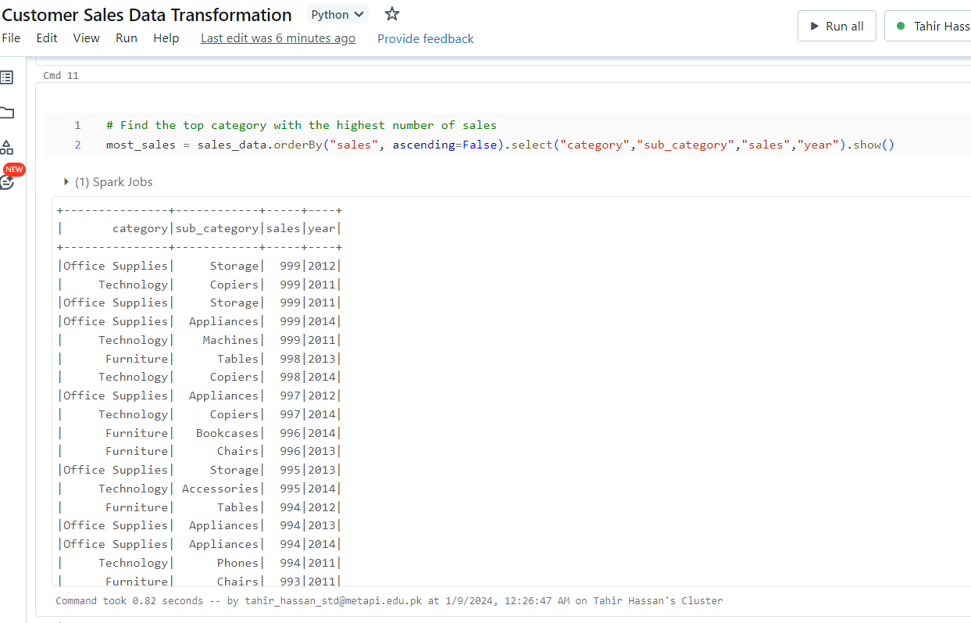
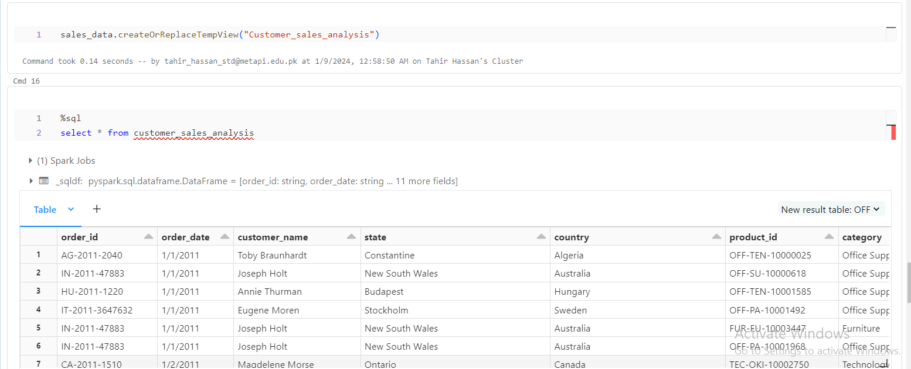
Implementation – Analysis

Slide 18
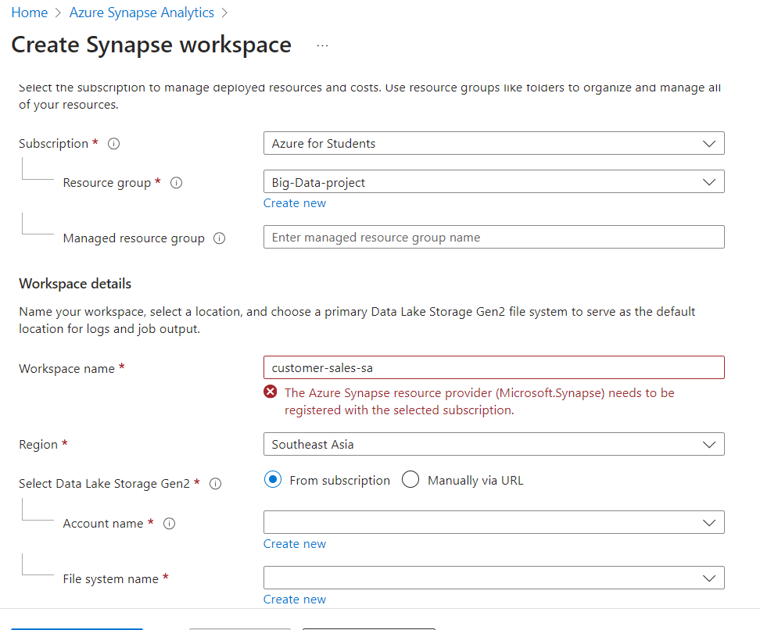
Implementation – Synapse Analytics

Slide 19
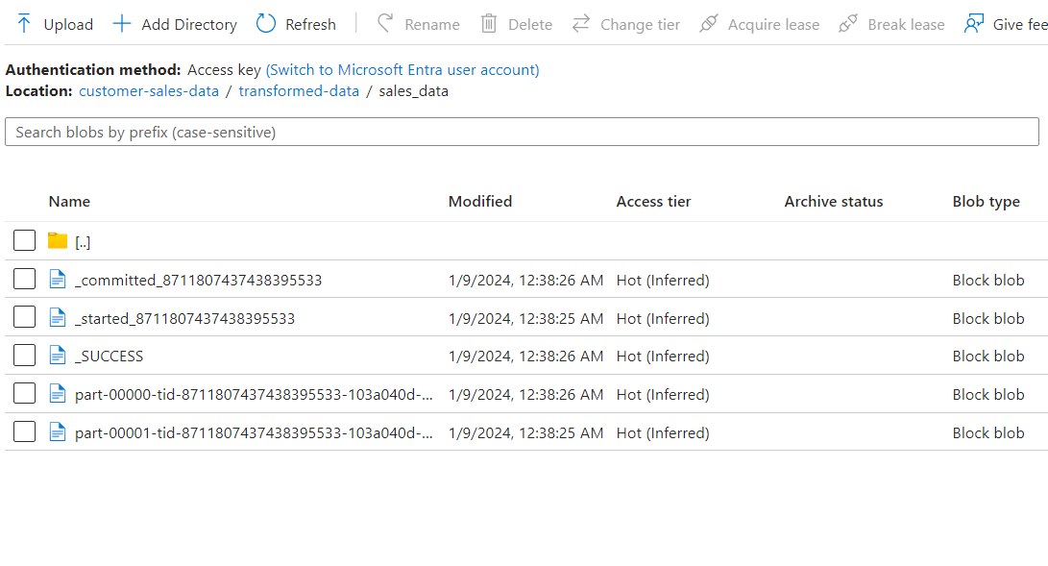
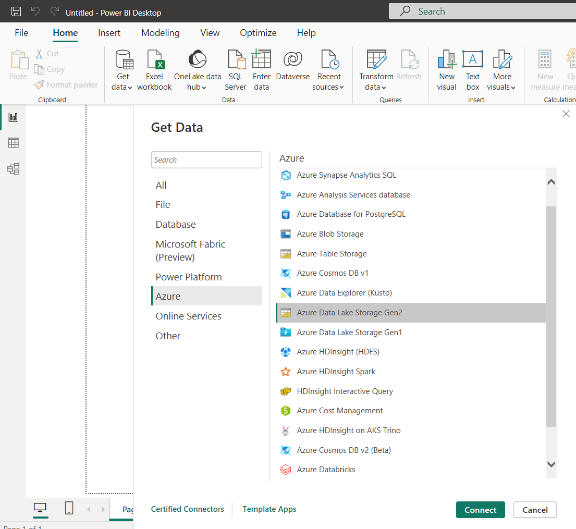
Implementation – Powerbi

Slide 20
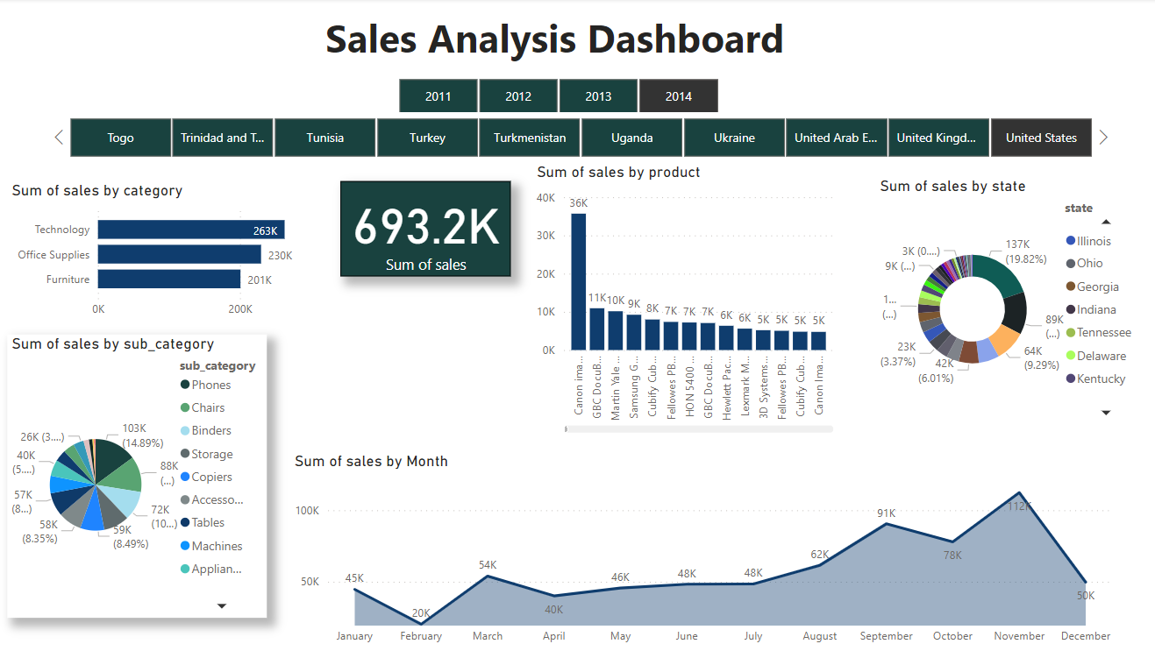
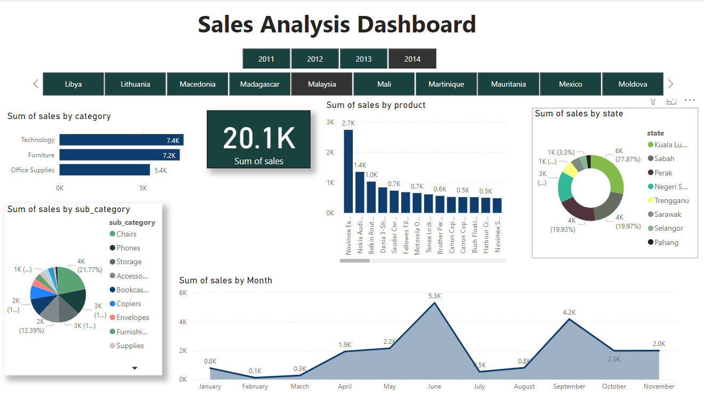
Implementation – Powerbi

Slide 21
Thank you

